Slide 1

ARKA Educational & Cultural Trust JAIN INSTITUTE OF TECHNOLOGY Davanagere-577003, KARNATAKA
DEPARTMENT OF ELECTRONICS AND COMMUNICATION
ENGINEERING
FINAL YEAR B.E. (2023– 2024)
Major Project Phase 2 Presentation on
“CartMate: An Automated Shopping Companion”
UNDER THE GUIDANCE OF:
Mrs. PUSHPALATHA O
Assistant professor
Dept. of E&CE,
JIT, DVG.
PROJECT ASSOCIATES
Abdul Majeed Kaif N (4JD20EC001)
Bharath B J (4JD20EC004)
Mohammed Sanaulla (4JD20EC027)
Akhilesh V Desai (4JD21EC400)

Slide 2
29 May 2024
ABSTRACT
This exciting plan aims to transform old-fashioned store visits by combining Embedded technologies. This technology upgrade is targeted at enhancing effectiveness and user-friendliness in the retail field, thus enabling a simpler and more interesting shopping ordeal. The implementation of clever shopping wagons, a crucial part of this novelty, decreases checkout times and provides live data, resulting in a more effective shopping procedure.

Slide 3
29 May 2024
CONTENTS
INTRODUCTION
LITERATURE SURVEY
METHODOLOGY
WORKING AND IMPLEMENTATION
HARDWARE EQUIPMENTS
SOFTWARE REQUIREMENTS
RESULTS
ADVANTAGES AND DISADVANTAGES
APPLICATIONS
CONCLUSION
REFERENCES

Slide 4
CHAPTER 1
29 May 2024
INTRODUCTION
CartMate, our cutting-edge automated shopping companion, redefines the traditional shopping experience by seamlessly integrating innovative technologies designed to enhance convenience and efficiency. CartMate effortlessly follows shoppers, eliminating the need for manual cart navigation. Additionally, CartMate streamlines the checkout process through automated billing capabilities, allowing customers to bypass long queues and enjoy a swift transaction.

Slide 5
29 May 2024
1.1 PROBLEM STATEMENT
Shopping becomes tedious and tiring when we have to take the purchased items by using a cart as we have to pull it ourselves. The difficulty escalates with an increase in items as it adds to the weight. Additionally, the traditional shopping process is time-consuming and environmentally unfriendly due to the necessity of standing in queues for billing and the generation of paper bills. To address these issues, we propose CartMate, a smart cart that can follow the customer automatically, and streamline the billing process to save time and reduce paper waste.

Slide 6
29 May 2024
1.2 OBJECTIVES
The objectives of CartMate system include:
To create user friendly shopping environment.
To automate the shopping cart to reduce the shopping time as well as the check-out time.
To reduce the burden of carrying the cart.

Slide 7
CHAPTER 2
29 May 2024
LITERATURE SURVEY
TITLE OF PAPER | AUTHOR AND YEAR OF PUBLICATION | WORKDONE | SHORTCOMES
Smart cart with Automatic Billing, Product information, Product Recommendation Using RFID & Zigbee with Anti-Theft | A. Yewatkar, F. Inamdar, R. Singh, Ayushya and A. Bandal - 2020 | Used RFID and ZIGBEE to create the list of items. | The paper proposes a smart shopping cart system that uses RFID and Zigbee to keep track of purchased products and generate bills for customers
Development of smart shopping carts with customer-oriented service | H. H. Chiang - 2018 | Used a display oriented approach for managing and payment of cart items. | The system uses RFID tags to detect products added to the cart and show related information on the user interface.

Slide 8
29 May 2024
A Review of Smart Shopping Systems | S. Sojitra1 and R. G. Patel 2017 | Proposed an idea about futuristic automated carts. | An overall review was done on the benefits of Smart Shopping Systems
IOT based Smart Shopping Trolley With Mobile Cart Application | S Kowshika, G Madhu Varshini, V Megha, K Lakshmi - 2021 | The proposed smart cart in this paper , is capable of generating bill using IoT along with mobile cart application | Auomatic human following is not included in the proposed paper.

Slide 9
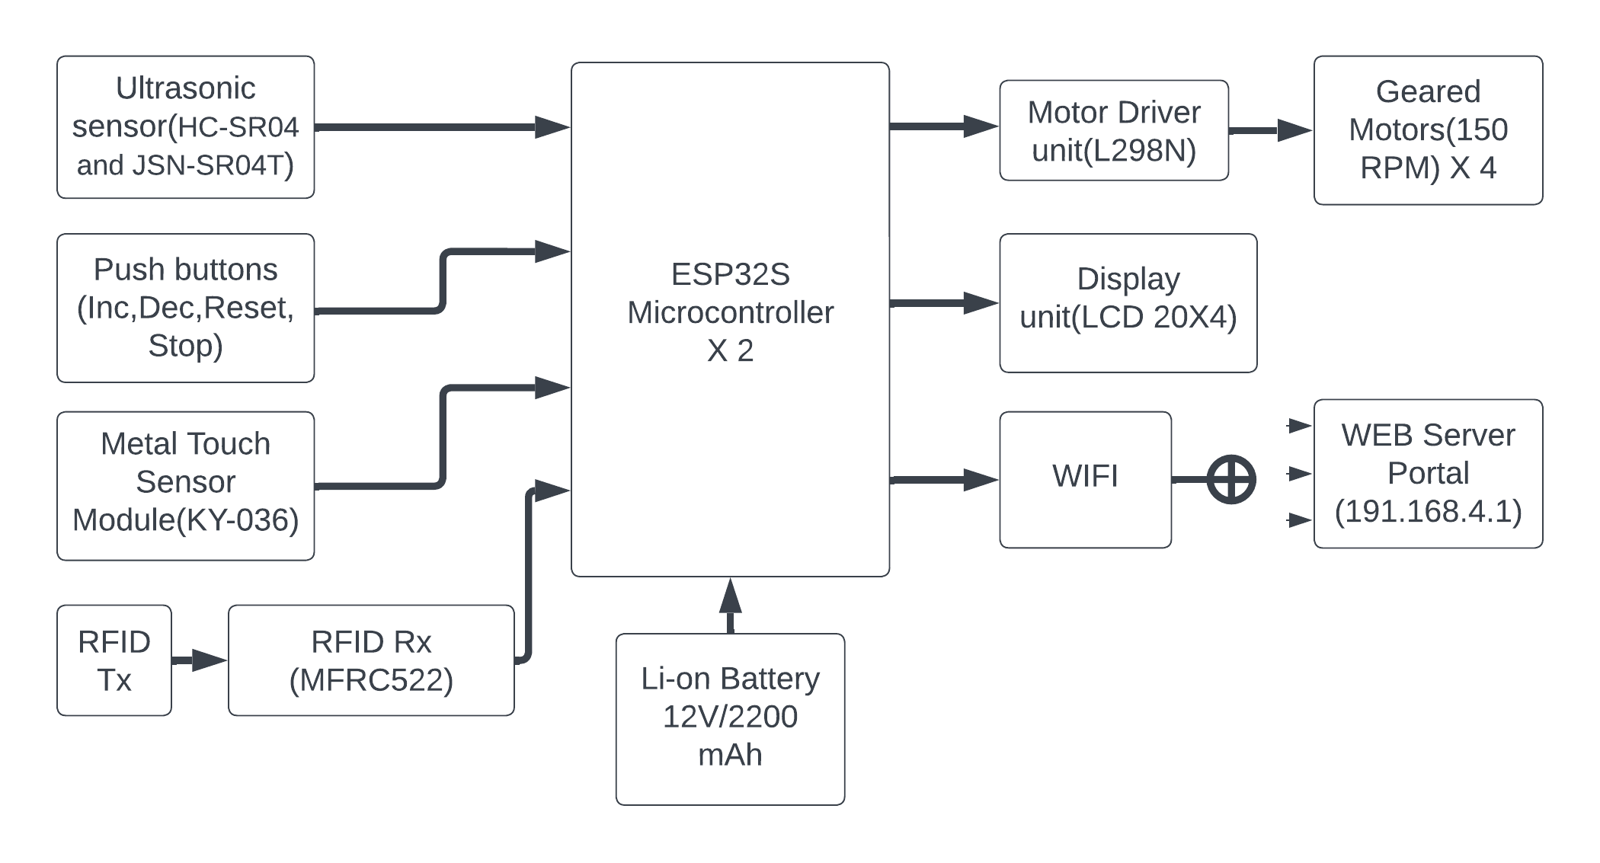
CHAPTER 3
29 May 2024
METHODOLOGY
Figure 1 Block diagram of the proposed system

Slide 10
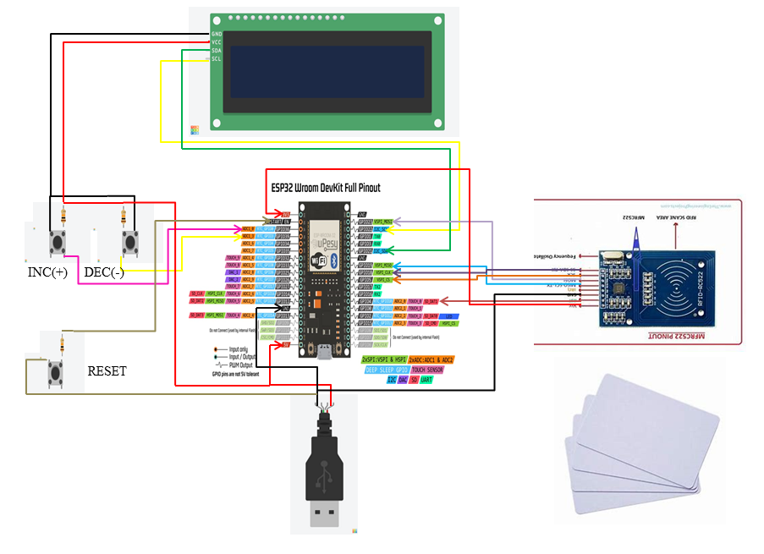
3.1 WORKING AND IMPLEMENTATION
29 May 2024
Figure 2 Implementation Diagram For Shopping System

Slide 11
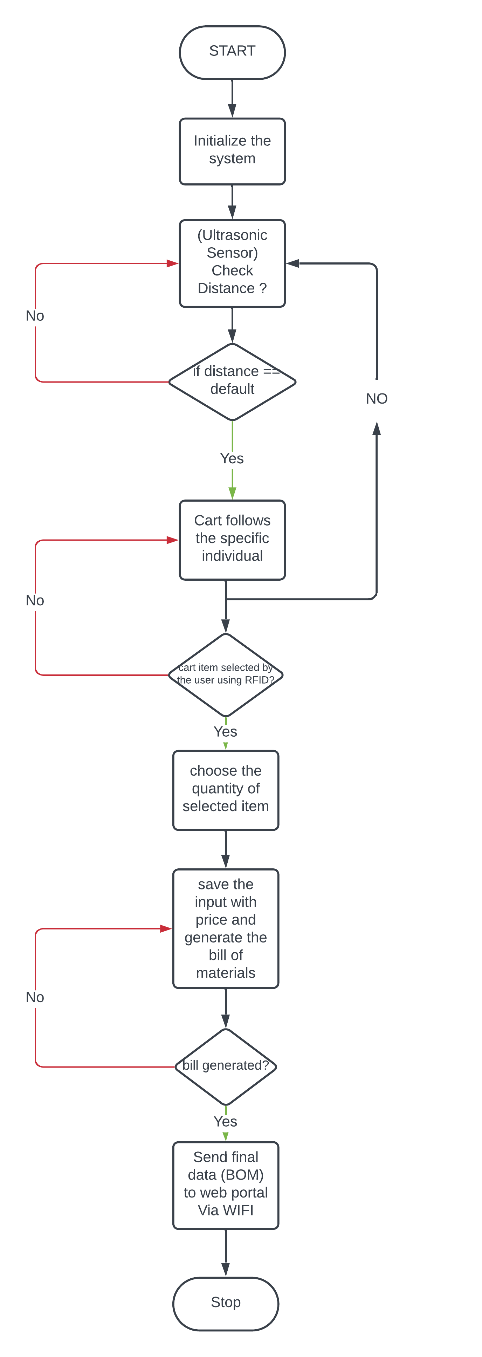
3.2 FLOWCHART
29 May 2024
Figure 3 Flowchart

Slide 12
CHAPTER 4
29 May 2024
4.1 HARDWARE EQUIPMENTS
ESP32 MICROCONTROLLER
ULTRASONIC SENSOR (HC-SR04)
RFID TRANSRECEIVER (MFRC522)
MOTOR DRIVER UNIT (L298N)
VOLTAGE REGULATOR IC (LM7805)
4.2 SOFTWARE REQUIREMENTS
The Software version we have used here is ARDUINO IDE 2.1.1 .

Slide 13
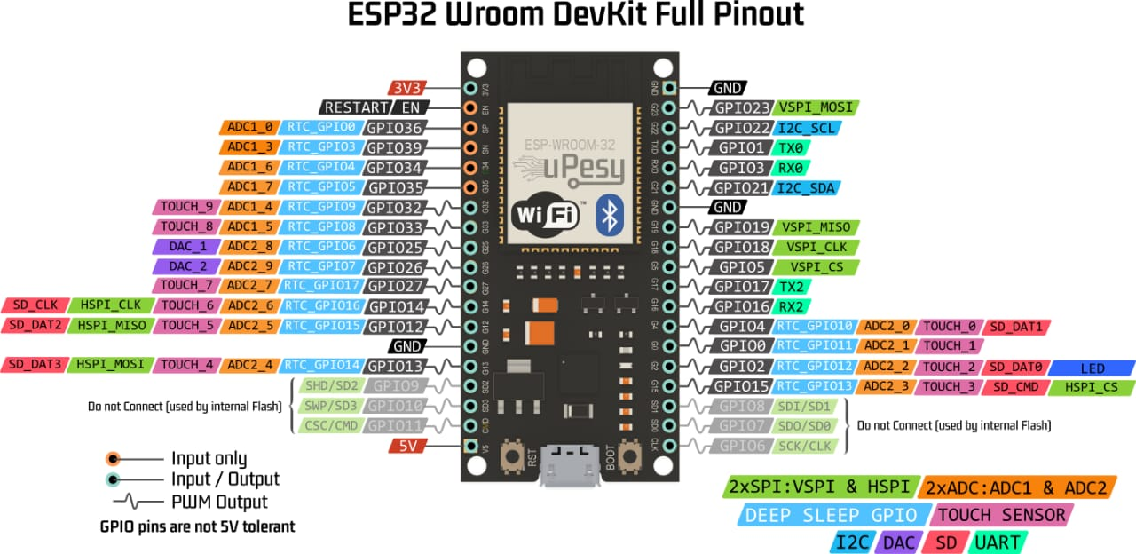
4.1 HARDWARE EQUIPMENTS
29 May 2024
Figure 4.1 ESP-32 MICROCONTROLLER
ESP-32 Microcontroller supports Wi-Fi, both 2.4 GHz and 5 GHz bands, allowing seamless connectivity to local networks or the internet.
The ESP32 board also offers multiple interfaces and peripheral options

Slide 14
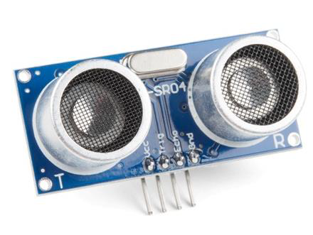
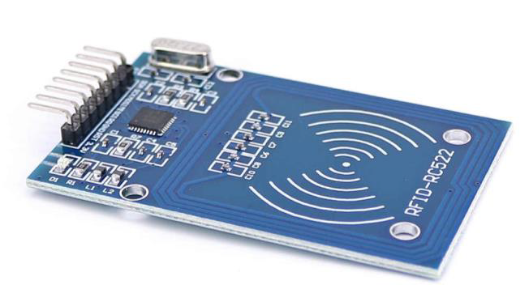
29 May 2024
Figure 4.2 depicts the HC-SR04 Ultrasonic Sensor, a widely used sensor for applications involving distance measurement or object sensing.
Figure 4.2 Ultrasonic Sensor (HC-SR 04)
Figure 4.3 illustrates the MFRC522 RFID Transceiver which is a highly integrated reader/writer IC for contactless communication at 13.56 MHz.
Figure 4.3 RFID Transreceiver (MFRC-522)
Dept. of E&CE, JIT, DVG

Slide 15
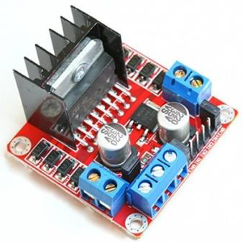
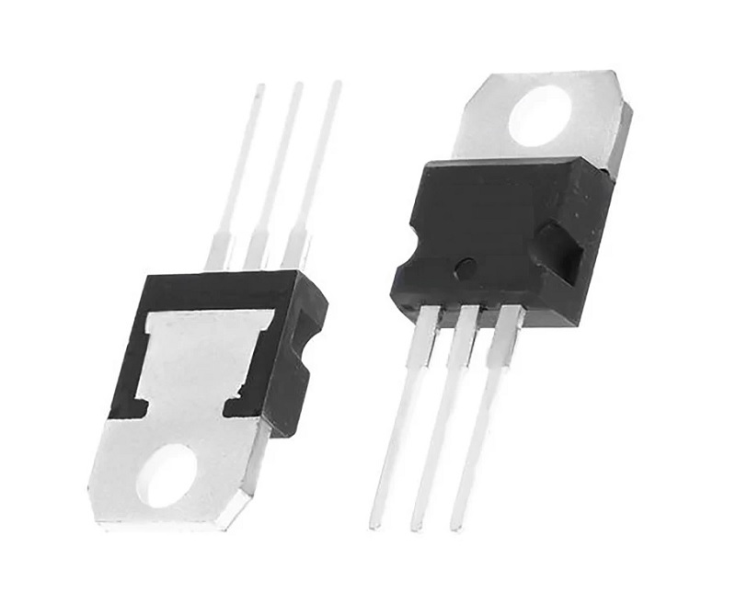
29 May 2024
Figure 4.4 depicts the L298N Motor Driver Module, a high-power module designed for driving DC and Stepper Motors.
Figure 4.4 Motor Driver Unit (L298N)
Figure 4.5 illustrates 7805 voltage regulator is an integrated circuit designed to maintain a constant output voltage despite changes in input voltage and load.
Figure 4.5 Voltage Regulator IC (LM7805)
Dept. of E&CE, JIT, DVG

Slide 16

4.2 SOFTWARE REQUIREMENTS
29 May 2024
The open-source Arduino Software (IDE) makes it easy to write code and upload it to the board. This software can be used with any ESP32 board.
Figure 4.6 ARDUINO IDE 2.1.1

Slide 17
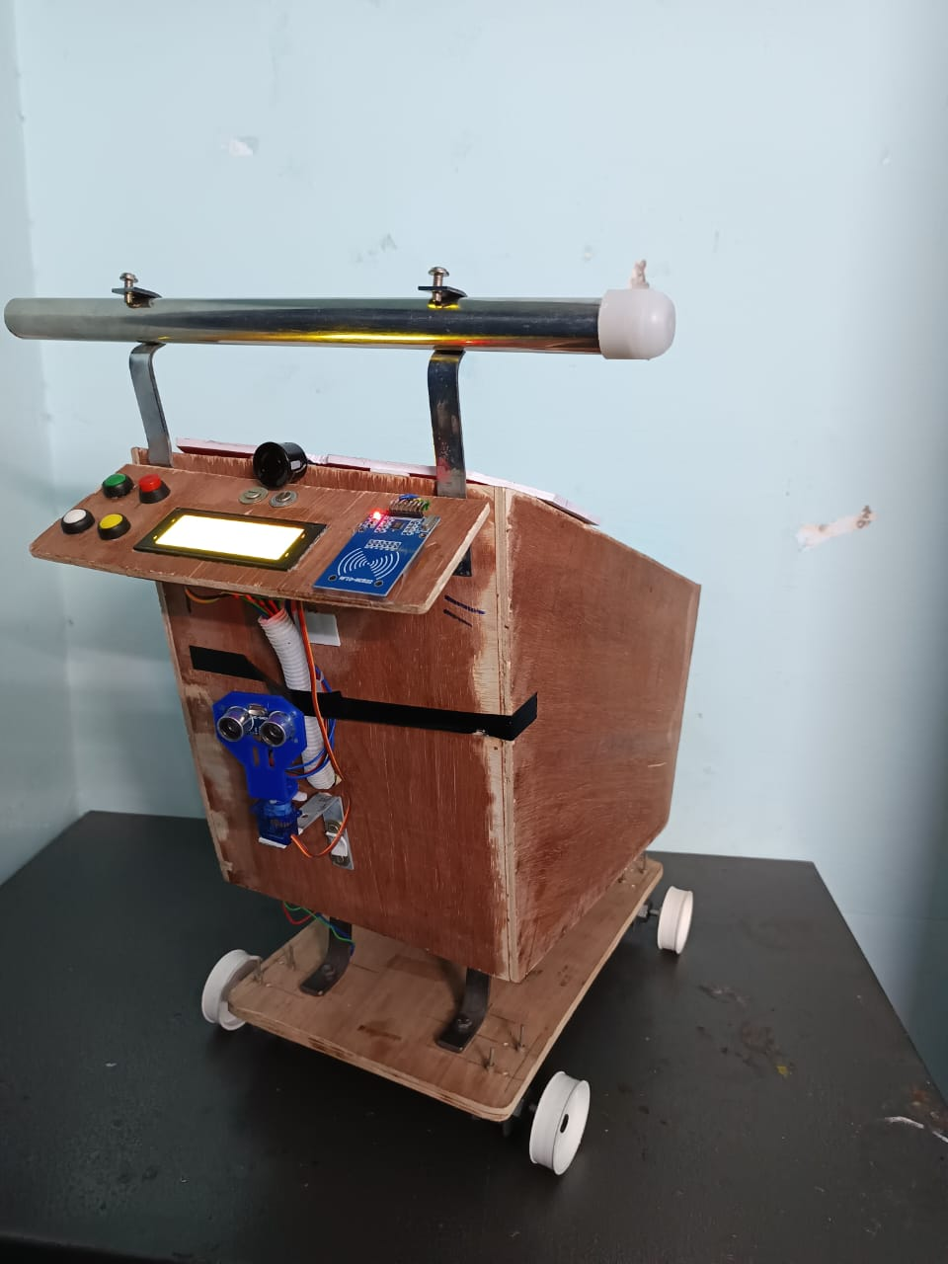
CHAPTER 5
29 May 2024
RESULTS AND DISCUSSIONS
Figure 4 illustrates the prototype circuitry of the CartMate system. Upon initialization (powering on), the user is required to connect to the CartMate’s local Wi-Fi network. It is essential for the user to remain within the operational range of the CartMate for it to effectively follow the user. This range is typically set between 30 to 40 centimeters to prevent interference from other users within proximity of the CartMate.
Figure 4 The CartMate Prototype

Slide 18
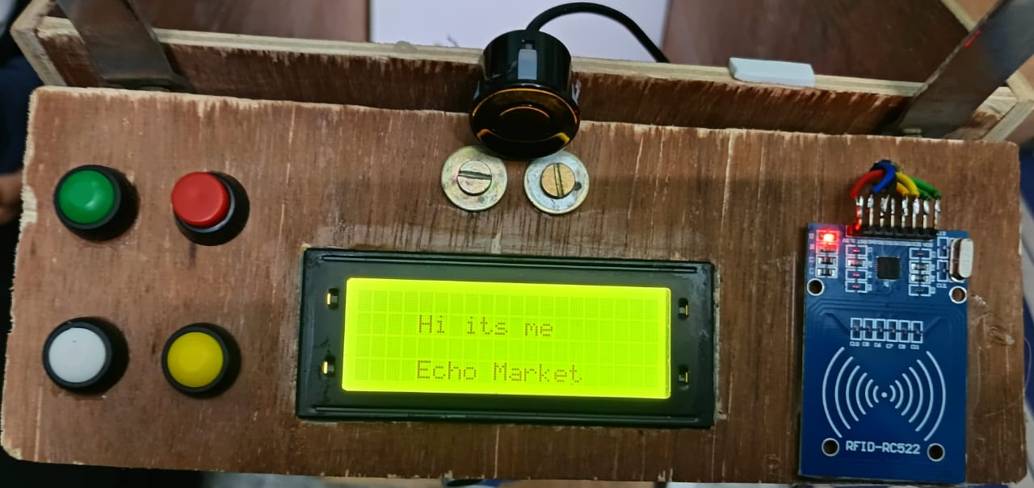
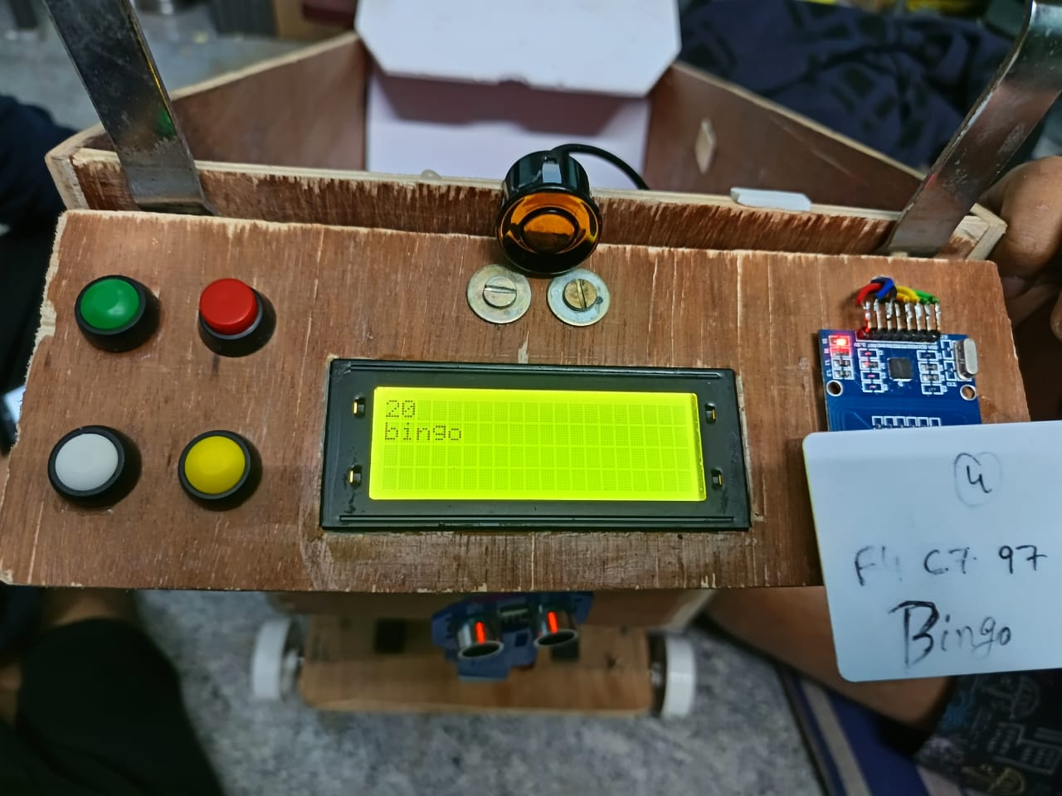
29 May 2024
Figure 5 demonstrates that the CartMate system is in ‘follow’ mode, ready to accompany the user. This state is signified by a specific greeting displayed on the LCD dashboard of the CartMate.
Figure 5 CartMate Greeting Customers
Figure 6 depicts the initial item scanned (represented by ‘bingo’ in the referenced image). This action is accomplished by utilizing the RFID scanner located on the CartMate’s dashboard.
Figure 6 After Scanning the item

Slide 19
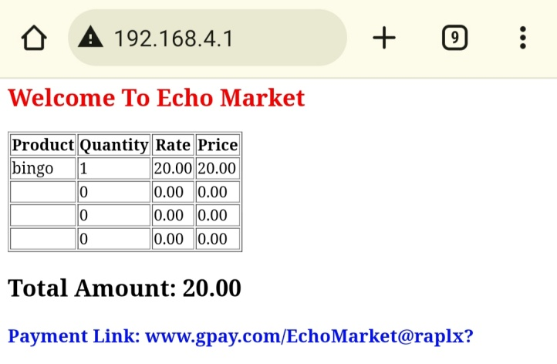
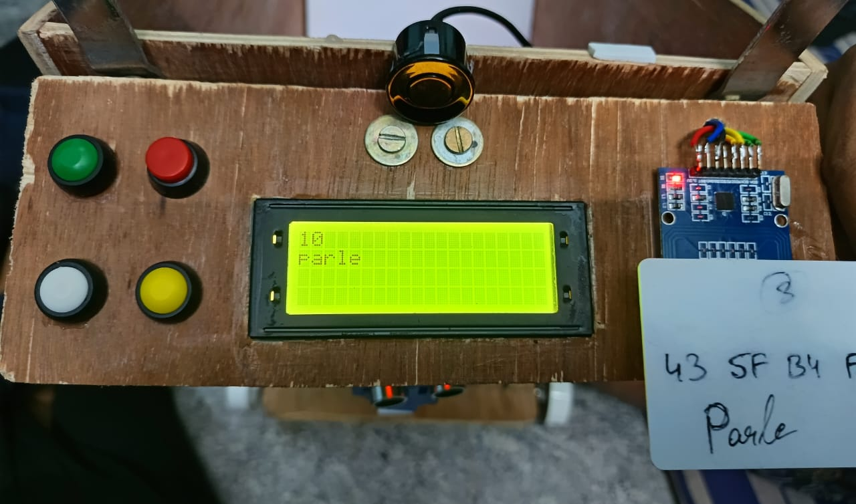
29 May 2024
Figure 7 illustrates that the information of the initial scanned item is transmitted in real-time to the user’s mobile device via Wi-Fi.
Figure 7 Scanned item is updated in Customer’s Mobile Phone
Figure 8 presents the second item scanned (represented by ‘parle’ in the referenced image). This process is also executed by using the RFID scanner integrated into the CartMate’s dashboard.
Figure 8 Next Scanned item
Dept. of E&CE, JIT, DVG

Slide 20
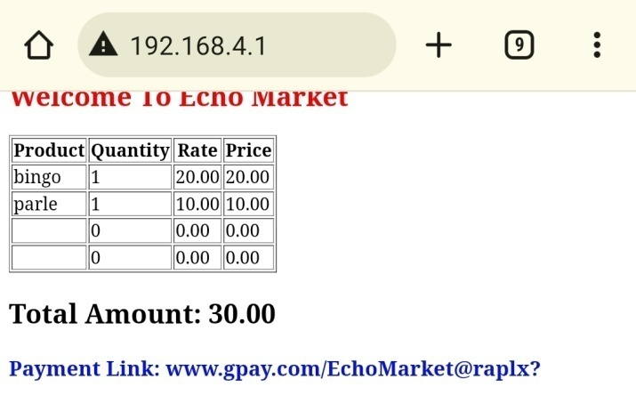
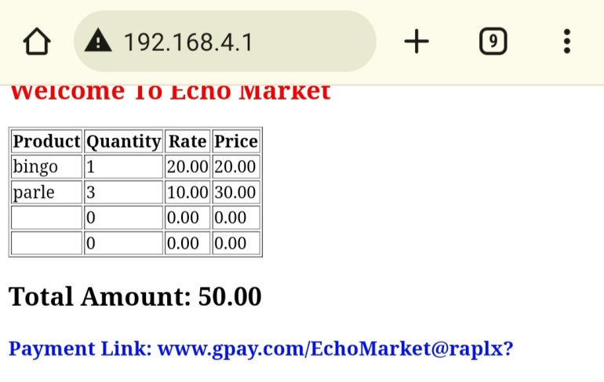
29 May 2024
Figure 9 illustrates that the second item, once scanned, is updated in real-time to the customer’s mobile phone via Wi-Fi.
Figure 9 Next Scanned item updated
Fig. 10 demonstrates that upon completion of the customer’s shopping, the website displays the total number of items added to the cart, the total payable amount, and provides a payment gateway integrated within the website for the customer’s convenience to complete the payment.
Figure 10 Items Incremented, Total Amount and Payment Gateway Displayed
Dept. of E&CE, JIT, DVG

Slide 21
CHAPTER 6
29 May 2024
ADVANTAGES AND DISADVANTAGES
6.1 ADVANTAGES
The CartMate uses various sensors to follow the customer around the store, providing a hands-free shopping experience.
The system generates the bill automatically through WiFi, eliminating the need for manual checkout.
The bill is directly sent to the customer’s mobile phone, making it easy to keep track of purchases, in the context of the pandemic, this system provides a contactless and hygienic shopping experience.

Slide 22
29 May 2024
6.2 DISADVANTAGES
The technology behind autonomous checkout may require a larger investment, which could be a barrier for some retailers.
The automated system reduces the amount of human interaction, which some customers may miss.

Slide 23
CHAPTER 7
29 May 2024
APPLICATIONS
Retail stores can use this technology to enhance the shopping experience and increase efficiency.
The CartMate can be used in supermarkets and grocery stores to provide a seamless shopping experience.
Pharmacies can use CartMate to provide a contactless shopping experience, especially beneficial for elderly or immunocompromised customers.
In electronics stores, where products can be expensive, CartMate can provide additional security by tracking the items in the cart.

Slide 24
CHAPTER 8
29 May 2024
CONCLUSION
In conclusion, CartMate: An Automated Shopping Companion” is a groundbreaking project in retail technology. The former provides customer assistance and reduces physical strain, while the latter streamlines checkout, reduces wait times, and improves customer satisfaction by using advanced scanning and payment technologies. This solution allows retail staff to focus on complex customer issues, improving service quality. CartMate sets a new standard for retail experiences, demonstrating the transformative potential of technology in retail operations.

Slide 25
CHAPTER 9
29 May 2024
REFRENCES
S Kowshika, G Madhu Varshini, V Megha, K Lakshmi, “IoT based Smart Shopping Trolley With Mobile Cart Application”, 7th international conference on communication, computing and virtualization, Procedia computer science, 2021.
A. Yewatkar, F. Inamdar, R. Singh, Ayushya and A. Bandal,”Smart cart with Automatic Billing, Product Information, Product Recommendation Using RFID & Zigbee with Anti-Theft”, Proceedings of 7th international conference on communication, computing and virtualization, Procedia computer science, 79(2020), pp.793-800.
H. H. Chiang et al., “Development of smart shopping carts with customer-oriented service”, in proc. of International Conference on System Science and Engineering, Taiwan, pp. 1-2, 2018.
S. Sojitra1 and R. G. Patel, “A Review of Smart Shopping Systems”, International Research Journal of Engineering and Technology, Vol. 3, No. 5, pp. 2561-2563, 2017.

Slide 26
29 May 2024
THANK YOU…!

